Slide 1
Data 601 @ UMBC Class 1: data formats
Data 601
August 30, 2018
These notes are CC BY 4.0
If it were a real license, I'd use http://matt.might.net/articles/crapl/
Notes:
See also https://web.stanford.edu/class/stats101/intro/intro-lecture01.pdf for inspiration
Useful: https://arxiv.org/pdf/1503.05570.pdf
A Data Science Course for Undergraduates: Thinking With Data by Ben Baumer, The American Statistician Vol. 69 , Issue. 4

Slide 2
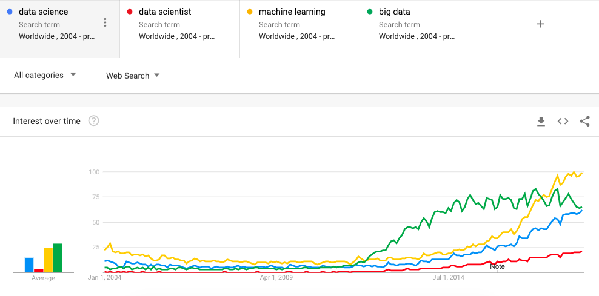
Welcome to Data 601
Once you've found a seat,
Introduce yourself to your neighbor
Ask them what their expectations are for Data 601
Notes:
https://trends.google.com/trends/

Slide 3
Outcomes for this evening
By the end of today's class, you should be able to answer the following:
What are three common plaintext data formats for semi-structured data?
What activities occur in the process of doing science?
What fields does data science draw on?
What is the motive for data science to occur?

Slide 4
Components of a good class
How do you promote a safe classroom environment?
How do you address the variety of backgrounds of participants?
How do you encourage participation? Enable rest?
What behavior fosters growth?
Activity: Think, write, gather

Slide 5
Ground rules
Schedule: 7:10 – 7:55, Break, 8:00 – 8:45, Break, 8:50 – 9:40
Also, it is acceptable to get up at any time and take a bathroom break
I value being punctual (start, breaks, end)
Raise your hand if you have a question
Don't apologize for asking a question or for not knowing something
I find it acceptable for you to occasionally not participate
Tell me if you cannot hear me or if you cannot understand me
Slides will be provided after lecture
I value your feedback:
Direct: verbal
Indirect: anonymous question/comment sheets on your desk

Slide 6
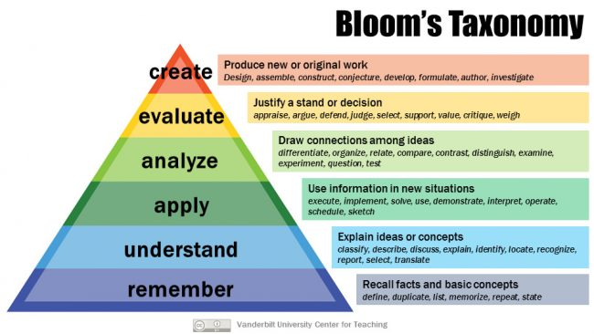
Grading Learning
What you may care about for evaluation
What I care about conveying
Attendance: 10%
Show up for class
Participate in class exercises and surveys
Homework: 30%
When homework is assigned, the due date will be provided
Mid-term project: 30%
Final project: 30%
Includes a presentation to the class

Slide 7

Log your assumptions and expectations
In-class exercise:
On a piece of paper or on your computer, record the date.
Write down your assumptions about this class
Write down your expectations for this class
Activity: think and write
Notes:
https://socialnicole.com/how-to-write-wikipedia-article/

Slide 8
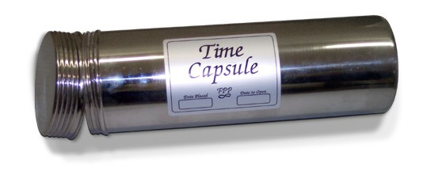
Store assumptions and expectations
We will revisit these notes later in the semester
Please store your note where it can be accessed later in the course
Notes:
https://hsefoundation.org/donate/time-capsule/

Slide 9

What do you want to learn in this class?
Activity: verbal popcorn
Notes:
Image source: https://www.compli.com/blog/survey/

Slide 10
Course schedule and outline (scope)
Aug 30: Overview Data Science
Sept 6: Python in Jupyter
Sept 13: Math (stats)
Sept 20: Regression
Sept 27: Clustering
Oct 4: Evaluation, cross-validation, overfitting
Oct 11: Substitute's choice
Oct 18: Getting data
Oct 25: Automation
Nov 1: Data cleanup
Nov 8: Scaling up
Nov 15: Property graphs
Nov 22: No class (Thanksgiving)
Nov 29: Elasticity, Cost/benefit
Dec 6: Ethics and Legality
Dec 13: Presentations

Slide 11
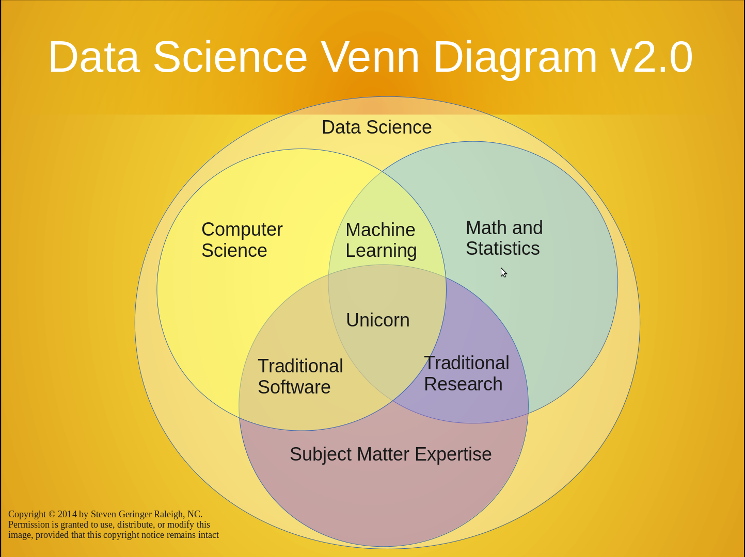
https://www.kdnuggets.com/2016/10/battle-data-science-venn-diagrams.html
There's a lot to cover
Suggested reading:

Slide 12
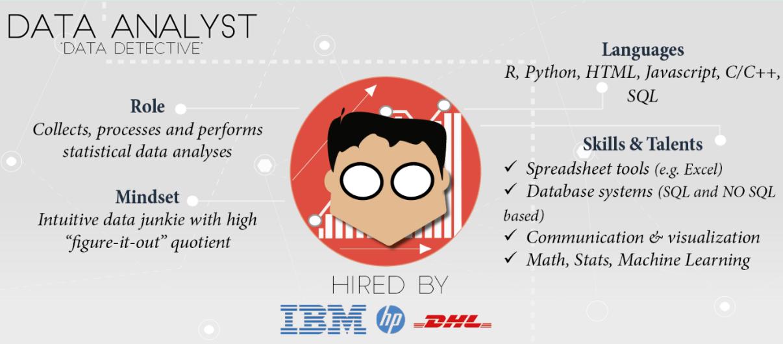
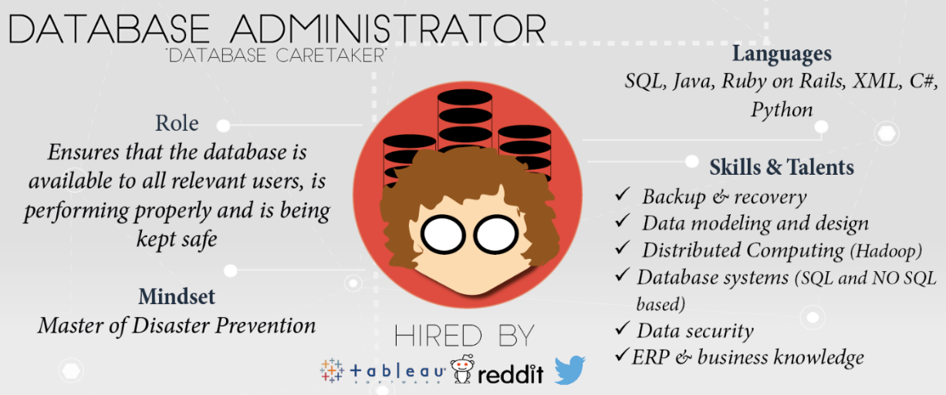
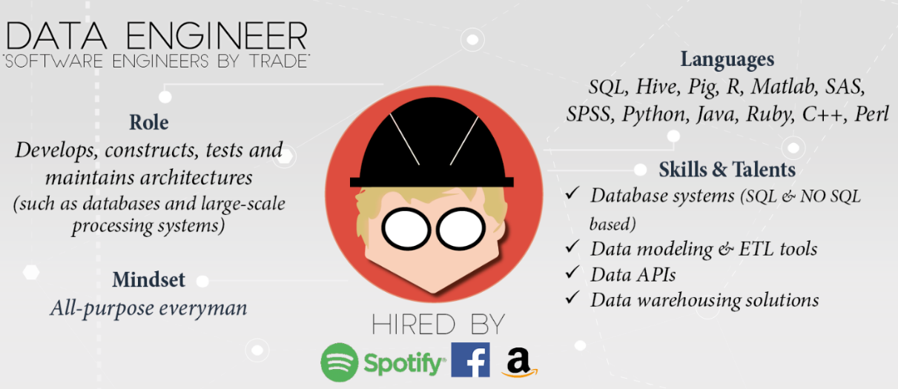
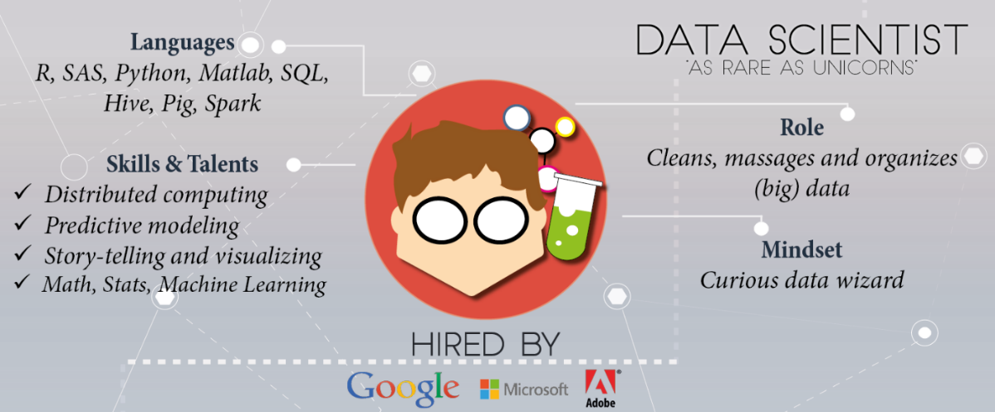
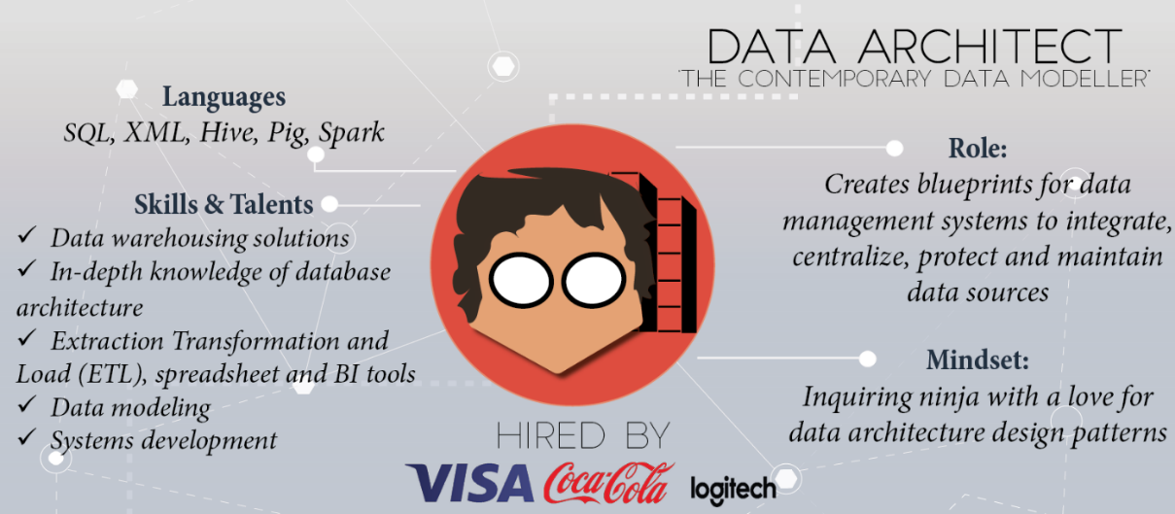
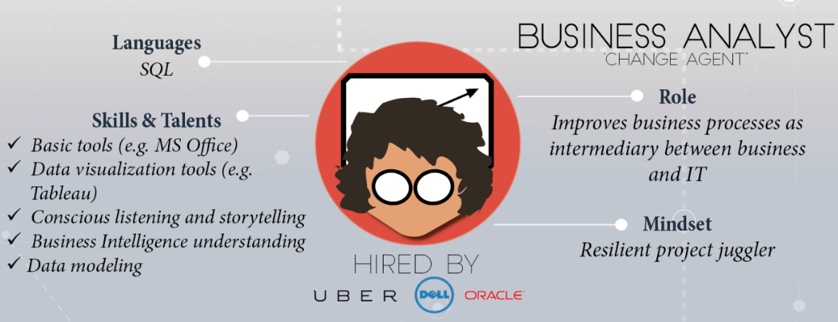
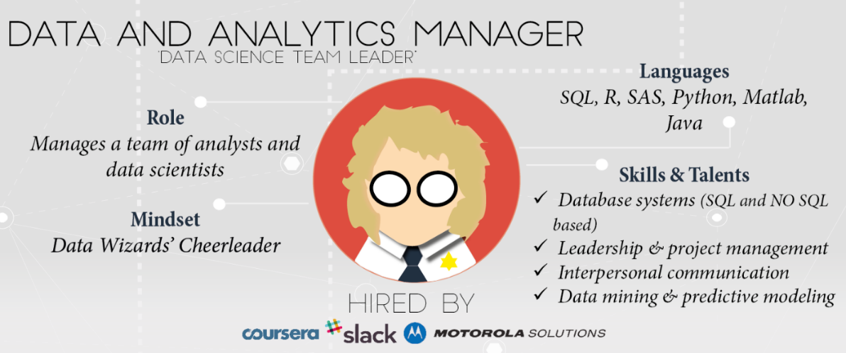
Skills and experience matter more than title and labels
https://www.datacamp.com/community/tutorials/data-science-industry-infographic
Historical progression: data grooming, data mining, data scientist

Slide 13
Data science is an active field with lots of jargon
There will always be something you haven't heard of before.
Know enough to be conversant with peers
Be curious about new topics
Research concepts and labels before using them
Reference: http://www.datascienceglossary.org/

Slide 14
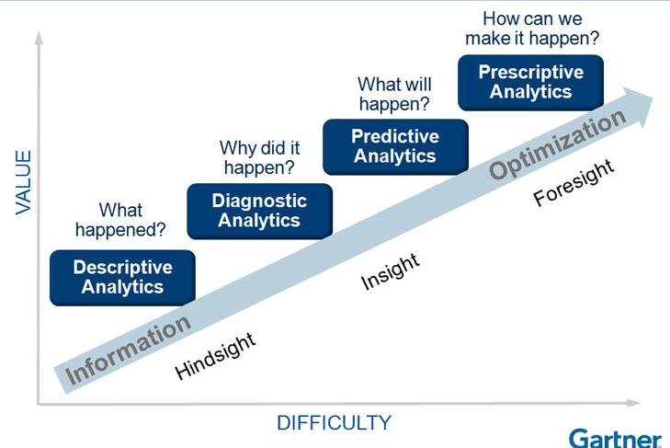
Why learn data science?
Explore: identify patterns​
Predict: make informed guesses​
Infer: quantify what you know
Motives:
Make money
Employment
Promotion
Help people
Gain new knowledge

Slide 15
Large scale use cases with lots of data
Google's search engine
Recommendations from Amazon and Netflix
Bank and Credit Card fraud detection
Logistics (DHL, UPS)
Healthcare
Each depends on availability of compute and data
Notes:
https://www.thrillist.com/entertainment/nation/how-new-netflix-recommendation-algorithm-works#
https://medium.com/netflix-techblog/artwork-personalization-c589f074ad76
https://www.wired.co.uk/article/how-do-netflixs-algorithms-work-machine-learning-helps-to-predict-what-viewers-will-like

Slide 16
Assumption in this class
In class we will assume you are a lone data scientist on an island with an internet connection.
This is not the typical case -- you'll have coworkers, customers, bosses, competitors, collaborators, peers.
Example of how class ≠ real world
This class will not use competitive grading. (Imagine if it were.)
As an employee at a company, you may be competing for a bonus or promotion
--> consequence: personal and organizational politics factor into the work environment

Slide 17
Small scale use cases with not much data
As a business employee or bureaucrat or politician
How do I improve decision making process?
How do I evaluate the outcome of decisions?
How do I decrease the risk when faced with an opportunity?
How do I convince other stakeholders of the best course of action?
While not taking too much time, spending too much money, using the resources I already have access to, and in a way that is convincing?

Slide 18
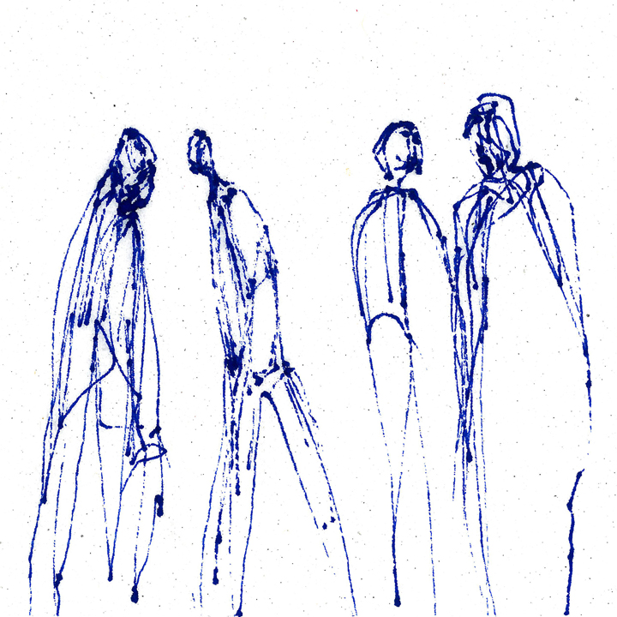
Most popular tool in data science
Stand up
Walk around
Introduce yourself to another person
Ask them what they think the most popular software tool in data science is
https://www.trippinsights.com/2018/01/04/milling-about/
Activity: interactive survey
Notes:
https://www.trippinsights.com/2018/01/04/milling-about/

Slide 19
Most popular tool in data science
Ben's claim: most popular tool in data science is Excel.
Excel is attractive because it's flexible and capable -- it can store data, the transform, and the visualization (no context switch).
However, as an analytic ages in Excel and is increasingly tailored, it becomes increasingly brittle.
Also, in the list of capabilities I didn't include documentation.

Slide 20
Most popular tool in Data 601: Python
Notes:
https://me.me/i/mustache-you-a-question-and-please-mullet-over-com-lilahdelilah-4900203

Slide 21


Most popular tool in Data 601: Python
Raise your hand if you have heard of the programming language called Python

Slide 22
Most popular tool in Data 601: Python
Raise your hand if you have used the programming language called Python

Slide 23
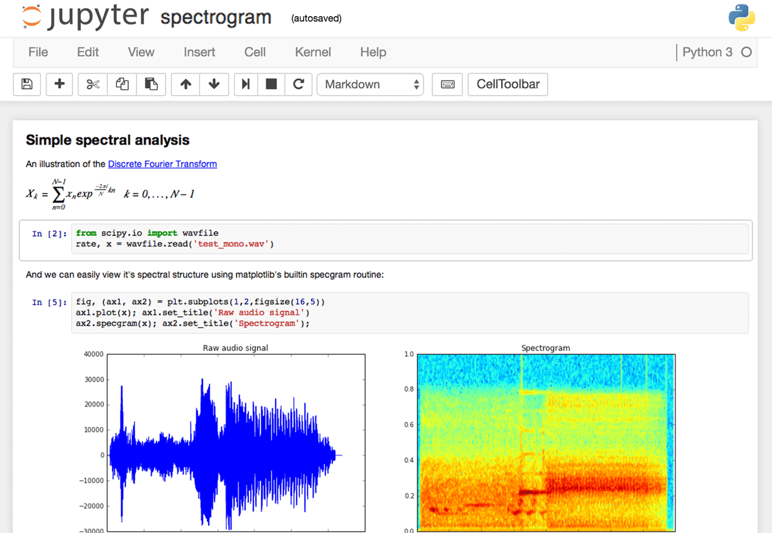
Interface to Python in Data 601: Jupyter
Raise your hand if you have used a Jupyter notebook
Notes:
Image source: https://www.dataquest.io/blog/jupyter-notebook-tips-tricks-shortcuts/

Slide 24

Why Jupyter + Python for Data 601?
Jupyter is useful for
Exploration of data (jargon: EDA = exploratory data analysis)
Documenting your activities (to enable reproducibility)
Figuring out which software is relevant, which algorithms to use, which software libraries are useful
Visualizing results
And both Jupyter and Python are free!
And both are widely used!
Notes:
Image source: https://imgflip.com/memetemplate/68354308/Do-all-the-things

Slide 25
Python and Jupyter do not cover every use case
For sufficiently large data sets, Jupyter and Python are not the right tool
For sufficiently complex analytics, Jupyter and Python are not the right tool
Speed and security are typically not your priority during exploration
Knowing when to invest in switching tools is a skill
Evaluate trade-offs of flexibility and security and speed for a given scale

Slide 26
Processes external to data science
Exploration may be enough and the effort terminates
Notes:
http://www.wiiplaygameslv.com/catalog/board_games-toyvault/but_wait_theres_more/406443

Slide 27

Processes external to data science
Exploration may be enough and the effort terminates
Additional refinement is often needed; data science is often merely the start of an investment
Notes:
http://www.wiiplaygameslv.com/catalog/board_games-toyvault/but_wait_theres_more/406443

Slide 28
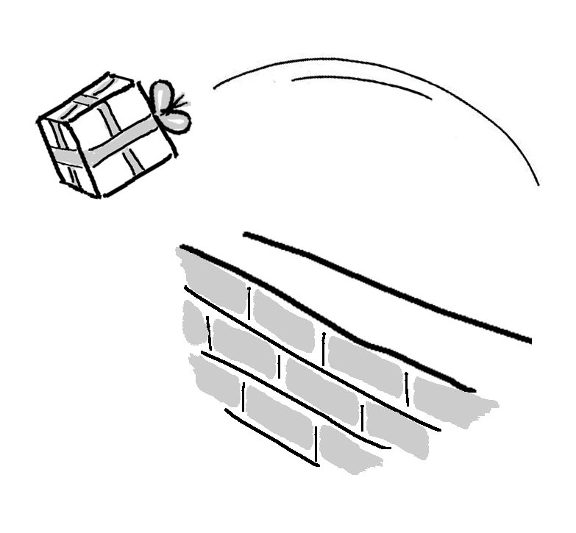
Not covered: product integration
There's a complex network of dependencies (i.e. software engineers, managers) of which data science is one component.
Downstream consumers of your output are likely to be software developers who use containers and support users.
This class is focused on the data science; not with integration.
See http://dev2ops.org/2010/02/what-is-devops/

Slide 29

Not covered: security
We focus on data science techniques; these do not emphasize secure design of software.
Notes:
https://betanews.com/2014/04/15/windows-8-1-without-update-will-no-longer-receive-security-updates/

Slide 30
We will discuss: data formats
Examples of data formats
CSV
Excel
JSON
XML
Unstructured text (i.e. txt)
Images (i.e. png, jpg, bmp, svg)
Sound (i.e. mp3, wav)
Images + sound: video
Plain text
Notes:
An outline of what I plan to cover in Data 601
https://www.loc.gov/preservation/resources/rfs/
https://www.loc.gov/preservation/resources/rfs/TOC.html
https://www.loc.gov/preservation/resources/rfs/stillimg.html#photodigital

Slide 31
Data formats
CSV
JSON
XML
Excel
Unstructured text
Images
Sound
Video
Plain text
Platform independent
Not tied to specific software
--> Recommended data formats by the Library of Congress
See http://www.loc.gov/preservation/resources/rfs/data.html
Notes:
An outline of what I plan to cover in Data 601
https://www.loc.gov/preservation/resources/rfs/
https://www.loc.gov/preservation/resources/rfs/TOC.html

Slide 32
Not covered:
unstructured text
Not covered:
image, sound, video
LDA
TF-IDF
word2vec
OCR
captioning
Object detection
Data 601 focus is on numerical data
and semi-structured text

Slide 33

Tables: what are they good for?
How would you represent course grades for Data 601 as a table?
(question is intentionally underspecified)
Activity: Raise your hand if you have a suggestion

Slide 34
Example of a table for course grades
Last Name | First Name | Homework 1 grade | Homework 2 grade | Exam grade
rgiasg | igmign | 79 | 84 | 92
qgimzf | gvdvig | 73 | 86 | 96
asgmi | ybgngfj | 58 | 42 | 71

Slide 35
Tables: what are they good for?
How would you represent a corpus of emails?
(question is intentionally underspecified)
Activity: Raise your hand if you have a suggestion

Slide 36
Example of a table for emails
Subject | From | To | Date | Has Attachment?
Doggy | Bob@gmail.com | Sam@yahoo.com | 2018-08-30 | N
Meeting time | Sam@yahoo.com | Alice@hotmail.com | 2018-09-01 | N
syllabus | Alex@gmail.com | Ari@gmail.com | 2018-09-06 | Y

Slide 37
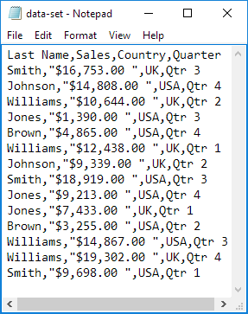
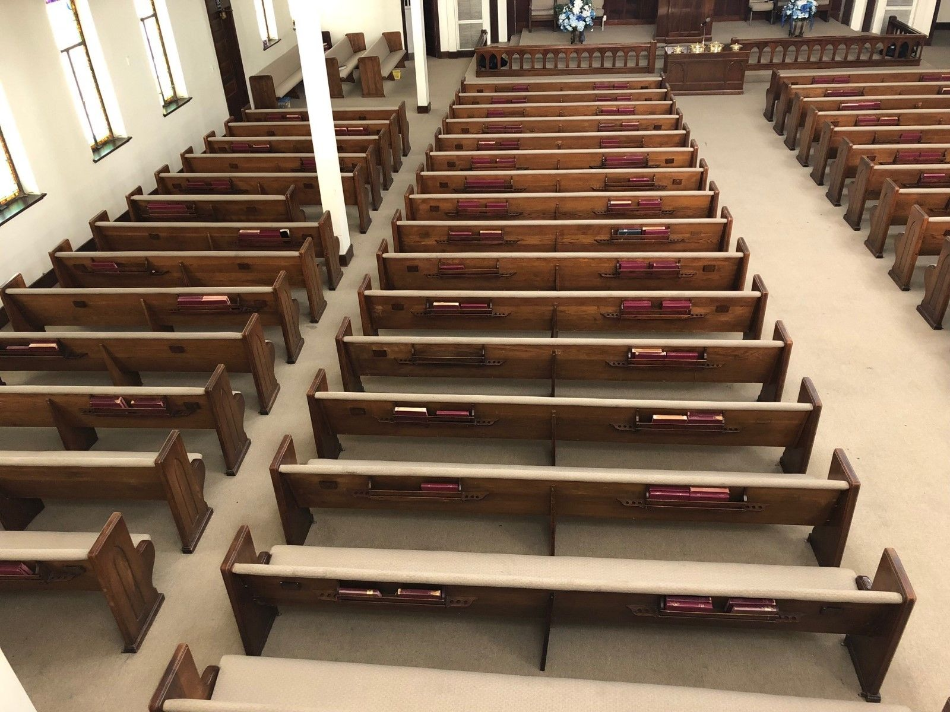

CSV
No set standard; see https://tools.ietf.org/html/rfc4180
https://en.wikipedia.org/wiki/Comma-separated_values
A table with rows and columns composed of text
Notes:
https://www.excel-easy.com/examples/import-export-text-files.html

Slide 38
CSV
No set standard; see https://tools.ietf.org/html/rfc4180
https://en.wikipedia.org/wiki/Comma-separated_values
A table with rows and columns composed of text
Two delimiters:
Line break
Comma
May or may not have a header:
First row is descriptions of columns
Notes:
https://www.excel-easy.com/examples/import-export-text-files.html

Slide 39
CSV caveats
Text (not images, audio, video)
Each column of same type
Name or word or description (text)
Number
Category label (text)
Delimiters within a value
Enclosed within a pair of double quotes: " "
Quotes for quotes, ie 24"
Notes:
Image: https://www.excel-easy.com/examples/import-export-text-files.html
https://tools.ietf.org/html/rfc4180
https://stackoverflow.com/questions/17808511/properly-escape-a-double-quote-in-csv

Slide 40
CSV variations
Delimiters vary:
Tab – see https://en.wikipedia.org/wiki/Tab-separated_values
| (pipe)
Month|count|location
Jan|1332|here
June|5,593|there
Feb|953,24|everywhere, CA
Oct|592|my home town, MD
Can you see why this would be desirable?
Notes:
https://en.wikipedia.org/wiki/Delimiter-separated_values

Slide 41
CSV alternative: fixed width
Consistent number of characters per column
ID l_name f_nametuition
0585822Potter, JrHarry 204
0485572Weasley Ron 958
5924245Granger Hermio422
4724926Diggory Cedric1042
4938243Weasley Fred 394
Can you see why this would be desirable?
Notes:
https://www.excel-easy.com/examples/import-export-text-files.html

Slide 42
CSV alternative: fixed width
Consistent number of characters per column
ID l_name f_nametuition
0585822Potter, JrHarry 204
0485572Weasley Ron 958
5924245Granger Hermio422
4724926Diggory Cedric1042
4938243Weasley Fred 394
Caveat: each column needs to be at least as long as the longest entry
Notes:
https://www.excel-easy.com/examples/import-export-text-files.html

Slide 43

CSV quiz
When you see the question, don't shout out the answer.
We'll be using the colored cards.

Slide 44
Name, year, class, grade
Ming, 2013, Data 601, B
Imgb, 2015, Data 601, B
Rimgw, 2012, Data 601, A
Wemf, 2014, Data 602, C

Slide 45
Name, year, class, grade
Ming, 2013, Data 601, B
Imgb, 2015, Data 601, B
Rimgw, 2012, Data 601, A
Wemf, 2014, Data 602, C
Q: Does this CSV have a header?
(Don't shout out the answer)

Slide 46
Name, year, class, grade
Ming, 2013, Data 601, B
Imgb, 2015, Data 601, B
Rimgw, 2012, Data 601, A
Wemf, 2014, Data 602, C
Q: Does this CSV have a header?
YES: vote with blue card
NO: vote with yellow card
NOT SURE: orange card

Slide 47
Name, year, class, grade
Ming, 2013, Data 601, B
Imgb, 2015, Data 601, B
Rimgw, 2012, Data 601, A
Wemf, 2014, Data 602, C
Q: Does this CSV have a header?
Answer -- YES: (blue card)
NO: vote with yellow card
NOT SURE: orange card

Slide 48
Name, year, class, grade
Ming, 2013, Data 601, B
Imgb, 2015, Data 601, B
Rimgw, 2012, Data 601, A
Wemf, 2014, Data 602, C
Q: How many rows does this CSV have?
(Don't shout out the answer)

Slide 49
Name, year, class, grade
Ming, 2013, Data 601, B
Imgb, 2015, Data 601, B
Rimgw, 2012, Data 601, A
Wemf, 2014, Data 602, C
Q: How many rows does this CSV have?
5 rows: vote with blue card
4 rows: vote with yellow card
NOT SURE: orange card

Slide 50
Row 1:
Row 2:
Row 3:
Row 4:
Row 5:
Name, year, class, grade
Ming, 2013, Data 601, B
Imgb, 2015, Data 601, B
Rimgw, 2012, Data 601, A
Wemf, 2014, Data 602, C
Col 1, Col 2, Col 3, Col 4
Q: How many rows does this CSV have?
Answer -- 5 rows: (blue card)
4 rows: vote with yellow card
NOT SURE: orange card
Why not 4?
Header is a row
Rows (5) versus columns (4)

Slide 51

ID, last name, first name, tuition
058582, Potter, Jr, Harry, $204
0485572, Weasley, Ron, $958
592424, Granger, Hermione, $422
472492, Diggory, Cedric, $1,042
493824, Weasley, Fred, $394
Q: What is wrong with this CSV?
Activity: raise your hand if you have an answer
Notes:
https://support.clever.com/hc/en-us/articles/218518698-How-do-I-troubleshoot-CSV-formatting-errors-
image
https://bensbargains.com/thecheckout/awesomeness/25-hilarious-images-will-definitely-trigger-nerd-rage/

Slide 52

ID, last name, first name, tuition
058582, "Potter, Jr", Harry, $204
0485572, Weasley, Ron, $958
592424, Granger, Hermione, $422
472492, Diggory, Cedric, "$1,042"
493824, Weasley, Fred, $394
Q: What is wrong with this CSV?
A: Two mistakes with unquoted commas
Notes:
https://support.clever.com/hc/en-us/articles/218518698-How-do-I-troubleshoot-CSV-formatting-errors-
image
https://bensbargains.com/thecheckout/awesomeness/25-hilarious-images-will-definitely-trigger-nerd-rage/

Slide 53
Jupyter and CSV
https://github.com/umbcdata601/fall2018/tree/master/jupyter_notebooks/week1

Slide 54
Additional common data formats: JSON and XML
Semi-structured_data for flexibility
JSON jargon: Key-value pairs
XML jargon: Tags, Elements, Attributes
Attributes contain data related to a specific element

Slide 55
Data format: JavaScript Object Notation (JSON)
{"menu": { "id": "file", "value": "File", "popup": { "menuitem": [ {"value": "New", "onclick": "CreateNewDoc()"}, {"value": "Open", "onclick": "OpenDoc()"}, {"value": "Close", "onclick": "CloseDoc()"} ] } }}
source: https://json.org/example.html
https://tools.ietf.org/html/rfc4627
Notes:
https://www.w3schools.com/js/js_json_intro.asp
https://beginnersbook.com/2015/04/json-tutorial/
https://www.tutorialspoint.com/json/

Slide 56
Data format: JavaScript Object Notation (JSON)
{"menu": { "id": "file", "value": "File", "popup": { "menuitem": [ {"value": "New", "onclick": "CreateNewDoc()"}, {"value": "Open", "onclick": "OpenDoc()"}, {"value": "Close", "onclick": "CloseDoc()"} ] } }}
source: https://json.org/example.html
https://tools.ietf.org/html/rfc4627
Notes:
https://www.w3schools.com/js/js_json_intro.asp
https://beginnersbook.com/2015/04/json-tutorial/
https://www.tutorialspoint.com/json/

Slide 57
Data format: JavaScript Object Notation (JSON)
{"menu": { "id": "file", "value": "File", "popup": { "menuitem": [ {"value": "New", "onclick": "CreateNewDoc()"}, {"value": "Open", "onclick": "OpenDoc()"}, {"value": "Close", "onclick": "CloseDoc()"} ] } }}
source: https://json.org/example.html
https://tools.ietf.org/html/rfc4627
Notes:
https://www.w3schools.com/js/js_json_intro.asp
https://beginnersbook.com/2015/04/json-tutorial/
https://www.tutorialspoint.com/json/

Slide 58
How many key value pairs does this JSON feature?
{"menu": { "id": "file", "value": "File", "popup": { "menuitem": [ {"value": "New", "onclick": "CreateNewDoc()"}, {"value": "Open", "onclick": "OpenDoc()"}, {"value": "Close", "onclick": "CloseDoc()"} ] } }}
source: https://json.org/example.html
https://tools.ietf.org/html/rfc4627
Notes:
https://www.w3schools.com/js/js_json_intro.asp
https://beginnersbook.com/2015/04/json-tutorial/
https://www.tutorialspoint.com/json/

Slide 59
How many key value pairs does this JSON feature?
{"menu": { "id": "file", "value": "File", "popup": { "menuitem": [ {"value": "New", "onclick": "CreateNewDoc()"}, {"value": "Open", "onclick": "OpenDoc()"}, {"value": "Close", "onclick": "CloseDoc()"} ] } }}
source: https://json.org/example.html
https://tools.ietf.org/html/rfc4627
There are 11 key value pairs
Notes:
https://www.w3schools.com/js/js_json_intro.asp
https://beginnersbook.com/2015/04/json-tutorial/
https://www.tutorialspoint.com/json/

Slide 60
Reading JSON in Jupyter
https://github.com/umbcdata601/fall2018/tree/master/jupyter_notebooks/week1

Slide 61
Data format: Extensible Markup Language (XML)
<menu id="file" value="File"> <popup> <menuitem value="New" onclick="CreateNewDoc()" /> <menuitem value="Open" onclick="OpenDoc()" /> <menuitem value="Close" onclick="CloseDoc()" /> </popup> </menu>
Element
Attribute
source: https://json.org/example.html
https://tools.ietf.org/html/rfc2376
attributes cannot contain multiple values (elements can)
attributes cannot contain tree structures (elements can)
Source: https://www.w3schools.com/xml/xml_attributes.asp
Notes:
https://www.w3schools.com/xml/
https://www.w3schools.com/xml/xml_whatis.asp
https://www.tutorialspoint.com/xml/

Slide 62
Multiple representations in XML
<person>
<firstName>John</firstName>
<lastName>Smith</lastName>
<age>25</age>
<address>
<street>21 2nd Street</street>
<city>New York</city>
<state>NY</state>
<zip>10021</zip>
</address>
</person>
There are no rules about when to use attributes or when to use elements in XML.
Source: https://en.wikipedia.org/wiki/JSON#XML_samples
<person firstName="John" lastName="Smith" age="25">
<address street="21 2nd Street" city="New York" state="NY" zip="10021" />
</person>

Slide 63
Reading XML in Jupyter
https://github.com/umbcdata601/fall2018/tree/master/jupyter_notebooks/week1

Slide 64
What is Science?
Science is a systematic enterprise that builds and organizes knowledge in the form of testable explanations and predictions about the universe.
https://en.wikipedia.org/wiki/Science
Notes:
https://web.stanford.edu/class/stats101/intro/intro-lecture01.pdf

Slide 65
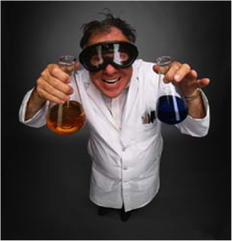
What is your perception of the process of Science?
Activity: turn to your partner, talk

Slide 66
How to Science
Observation
= Data
Test
= (in)validate assumptions
Curiosity about relations
Model = a story using math
to describe relations
in the data
Prediction
= based on assumptions
Notes:
https://www.youtube.com/watch?v=j12BBcKSgEQ

Slide 67
Make a claim, Test the claim
A claim should be falsifiable. The test should be statistically meaningful.
In practice, strictness depends on intended outcome.
Good enough to make money:
Altering what color the button on your ecommerce website is to maximize sales
Recommending a movie to viewers
Critical to safety or health of humans:
Determining which dosage of a drug is efficacious for medical treatments
Guidance for an autonomous vehicle

Slide 68
Hard task in Science: Reproducibility
Someone else, following only your documentation, should be able to get an outcome that validates your claim.
An investment without immediate benefit.
Who's impacted by reproducibility: your future self; others.
Notes:
https://en.wikipedia.org/wiki/Reproducibility
https://en.wikipedia.org/wiki/Replication_crisis

Slide 69
Example reasons why reproducibility fails
The outcome was specific to the data used
Assumptions were wrong
Software implementation has a bug
Documentation provided is insufficient to enable reproducibility
Notes:
https://en.wikipedia.org/wiki/Reproducibility
https://en.wikipedia.org/wiki/Replication_crisis

Slide 70
Best practices: Version control
Reproducibility applies to your own attempts (not just other people)
Regardless of how you develop analytics, you'll be creating or editing software and documents.
[lesson] Regardless of how you implement best practices, avoid inventing solutions for which someone else already provided a path.
Suggested resource: https://try.github.io/

Slide 71

Have you used software for version control?
Examples: git, svn, hg
Activity: Raise your hand for yes
Notes:
https://harveymilk.com/hmcra-family-survey-2/

Slide 72
Data Science is more than Math and Software
Human interaction in data science
Discovering stakeholders
Negotiating with data owners
Customer engagement
https://hbr.org/2017/01/the-best-data-scientists-get-out-and-talk-to-people

Slide 73
Iterating with customers
As a data scientist, you'll often be working for someone other than yourself.
Expect under-specified requirements from customers. Iterate.
Provide incomplete solutions rather than waiting until the product is perfect.
https://en.wikipedia.org/wiki/Minimum_viable_product

Slide 74

When to persist, When to change course, When to seek help
Try attacking the challenge for 30 minutes
Then seek help or do something else for a while
https://en.wikipedia.org/wiki/Pomodoro_Technique
Notes:
http://finalfantasy.wikia.com/wiki/Level_grinding
https://en.wikipedia.org/wiki/Grinding_(gaming)
https://www.vectorstock.com/royalty-free-vector/timer-sign-icon-30-minutes-stopwatch-symbol-vector-3756908

Slide 75
Pro-tip when seeking help
How to ask well-formed questions:
https://stackoverflow.com/help/how-to-ask
[Intentional sidetrack to StackOverflow.]

Slide 76


Emotions in Data Science
As a data scientist, most of your time will be spent in a desert of uncertainty, frustration, and doubt.
There will be rare short-lived interspersed spikes of excitement and happiness due to events like getting a new dataset, creating a new analytic, getting a new result, or being thanked by a stakeholder.
This experience is normal and does not go away.
See also the psychology of slot machines
Notes:
https://www.vhtcx.com/wp-content/uploads/2015/02/canstockphoto3986275.jpg
https://www.vhtcx.com/blog/5-causes-customer-frustration-fix/

Slide 77
Task: Jupyter with Python 3 kernel
Recommended: Local installation on your computer
https://jupyter.org/install
Requires Python installation, as well as either pip or conda
Backup: Web-based (free, no guarantee of availability, features vary)
https://colab.research.google.com/
https://mybinder.org/
Depends on reference to github repository
Optional Challenge: Create a Local Docker image that supports Jupyter

Slide 78
Online resources (in addition to books)
Slack channel for Data 601: https://umbcdatasci.slack.com/messages/
Meetups
https://www.meetup.com/topics/data-science/
https://www.meetup.com/BigDataBaltimore/
https://www.meetup.com/Statistical-Seminars-DC/events/254200651/
News and blogs
https://www.kdnuggets.com/
https://news.ycombinator.com/
https://hackernoon.com/
https://www.reddit.com/r/datascience/
https://dataelixir.com/newsletters/
Online courses
Coursera
https://www.coursera.org/learn/machine-learning/home/welcome

Slide 79
Homework
You will be assigned one of the following texts to read:
First 10 pages of "50 years of data science"
or
A Very Short History Of Data Science
Write a half page summary of the text
Turn via Blackboard
Bring your summary (electronic or on paper) to class on Sept 6, 2018
Action: Read, write, tell
Notes:
Timeline: http://www.dataversity.net/brief-history-data-science/

